Slide 3
Profile of the College
International School of Management ISM Slovakia in Prešov is a private non-university college.
The mission of the college is to develop a harmonious personality, knowledge, wisdom, goodness and creativity in humans, to develop knowledge based on creative research in the fields of economics, economics and social sciences and to contribute to the development of education, science, culture and health for the welfare of the whole society.

Slide 5
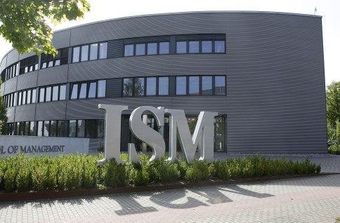
ISM Slovakia is part of private schools network ISM - established in Germany.

Slide 6
ISM Slovakia
Quality, relevant, attractive and flexible study programmes are creating an educational institution for exploring the international and interdisciplinary dimension of business in Prešov.

Slide 8
Study Programmes
Bachelor Study Programmes:
International Enterprising in Trade and Services
Social Services and Counselling
Economic and Business Ethics
Theory, Management and Services in Culture
Price per Semester is 700 €.

Slide 10
Master Study Programmes:
Public Relation Ethics and Business Protocol
Social Services and Counselling
Price per Semester is 850 €.

Slide 12
International Enterprising in Trade and Services
Why to study This Study Programme?
ATTRACTIVE
It mediates contacts with possible future employment during the studies.
MODERN
We use the latest didactic, information and communication technologies.

Slide 14
DYNAMIC
The content of seminars and training is adapted to the current needs of the society and to the latest information.
INNOVATIVE
We gain new knowledge on the international scientific events and we link them to practice.
PROFESSIONAL
We organise seminars led by experts from business environment and by managers of companies and businesses.

Slide 16
The Graduates
Manager in the middle management level (international companies, multinational corporations),
Sales representative (sales and distribution companies, insurance companies ...),
Business operator (business enterprises, business services and tourism ...).

Slide 18
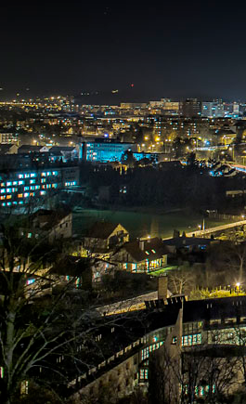
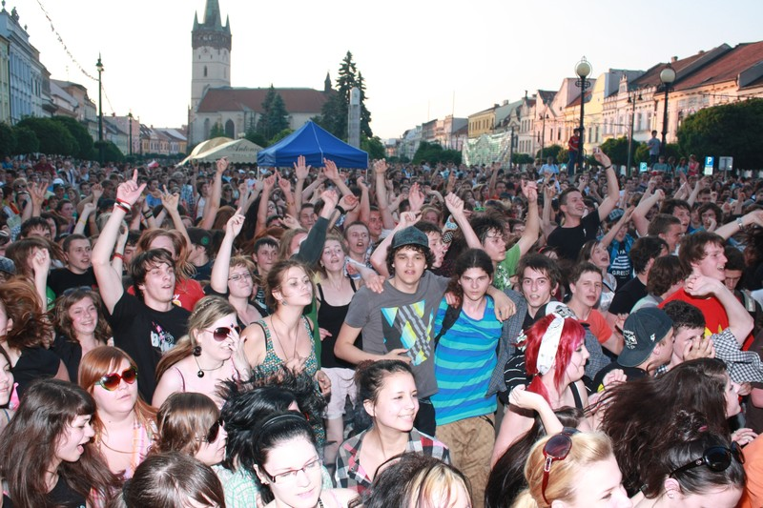
Welcome to Prešov - Slovakia
Dynamic town with unique atmosphere
Town of students with a true young spirit

Slide 19
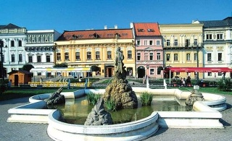
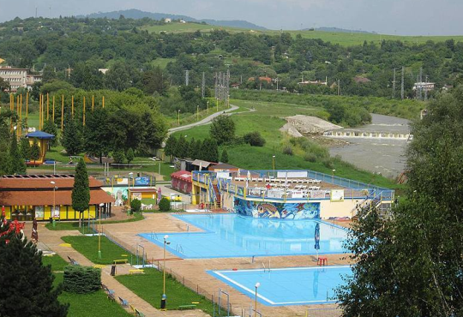
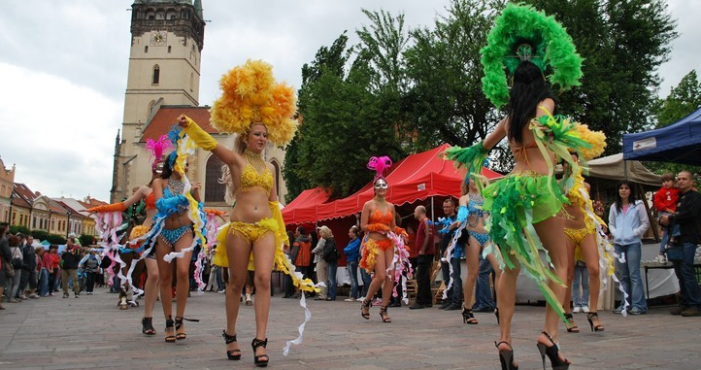
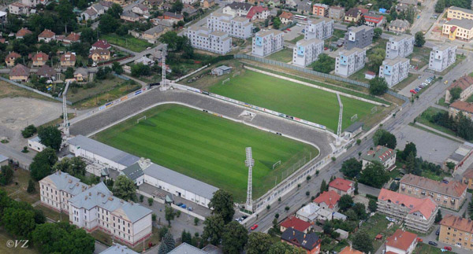
Prešov
3rd biggest town in Slovakia,
which has about 90 000 citizens
of different nationalities.
It is industrial, cultural, educational and sport centre.
Prešov belongs to the most significant historical towns in Slovakia and offers a wide range of cultural and social events, that you must see!

Slide 20
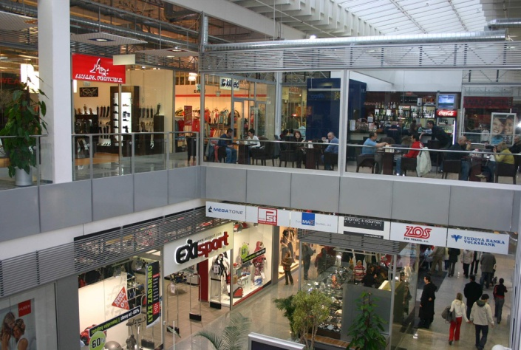
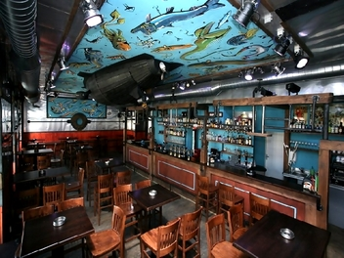
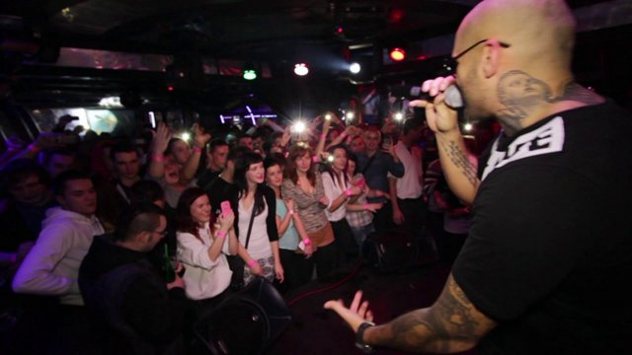
Culture of Prešov
Private galleries and museums keep the attention of visitors, who require the best quality.
The city offers many recreational places, where students can abreact after a hard day at school ;)

Slide 21
Some events in town
The Presov Music Spring
The Golden Kit (week of the Slovak libraries)
The Local Artist Fashion show
The International Day of Museums
The Festival of Sword-Play and Handicrafts
The Country Dance Fest Presov
The International Jazz Festival JAZZ Presov
The International Junior Bartender and Waiter Competition

Slide 22
Sport in Prešov
Prešov is a town of sport.
The most popular and most successful sports are:
- Handball (HT Tatran Prešov - Slovakia's most popular and currently most successful club),
- Football (1.FC Tatran Prešov - oldest football team in Slovakia),
- Ice Hockey.

Slide 23
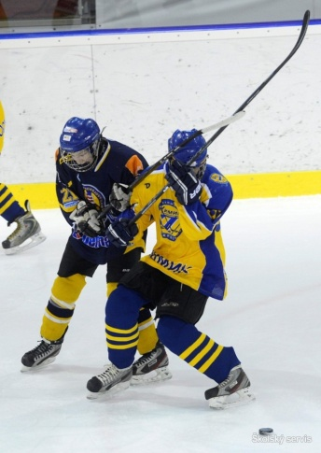
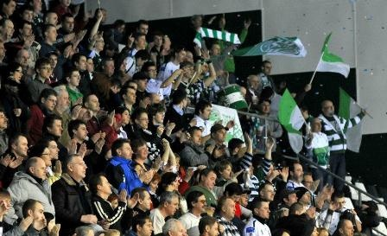
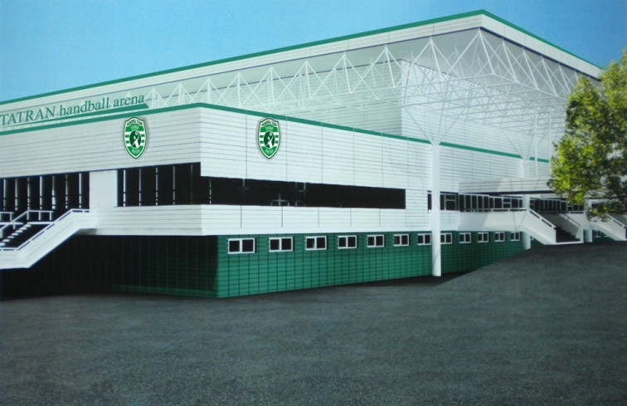
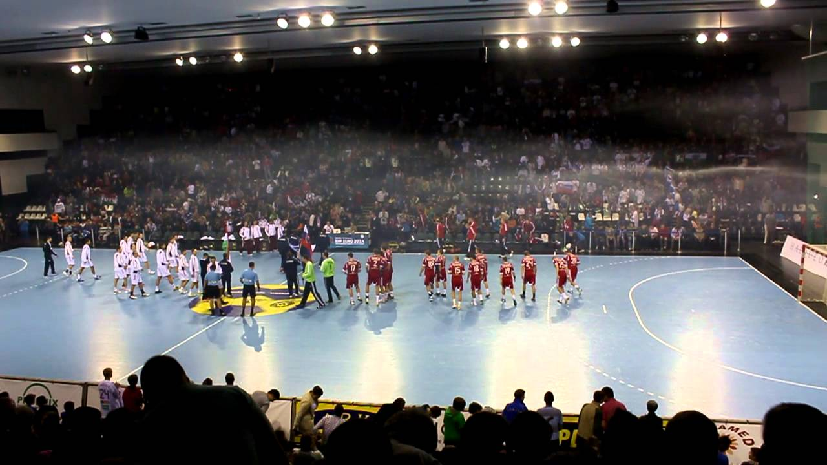
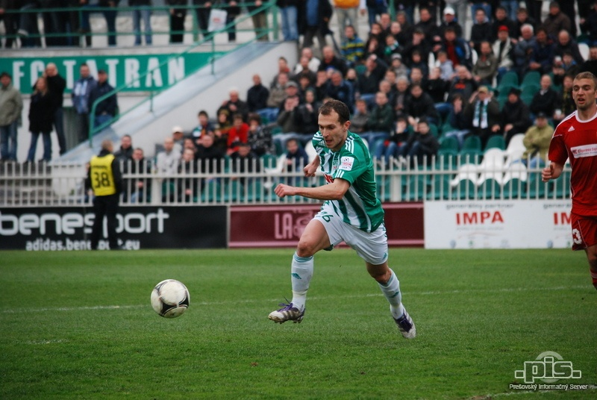
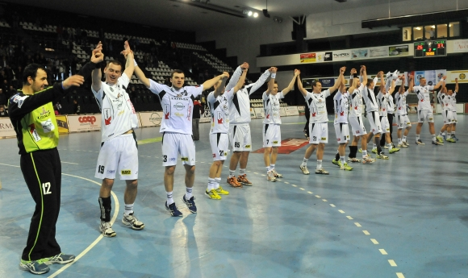

Slide 24
In Prešov are also other sports such as Basketball, Tennis, Volleyball, Water polo, Squash, Bowling and many others sports, which you can watch and play.
So, come on and enjoy our town! ☺
More informations about Prešov you can search on website: www.presov.info

Slide 25
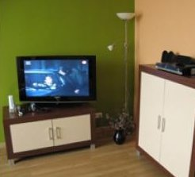
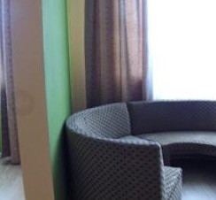
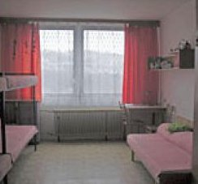
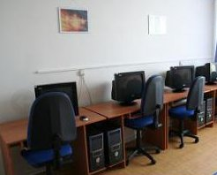
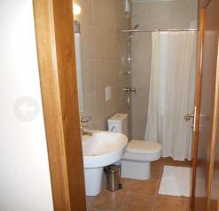
Accommodation
Accommodation is provided in a Student house near the College. Price is 110 € per month.

Slide 26
Let´s study together!

Slide 27
Join ISM Slovakia!

